Slide 1
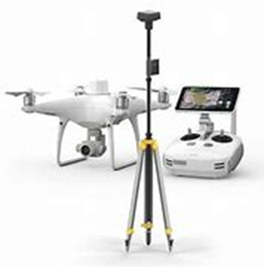
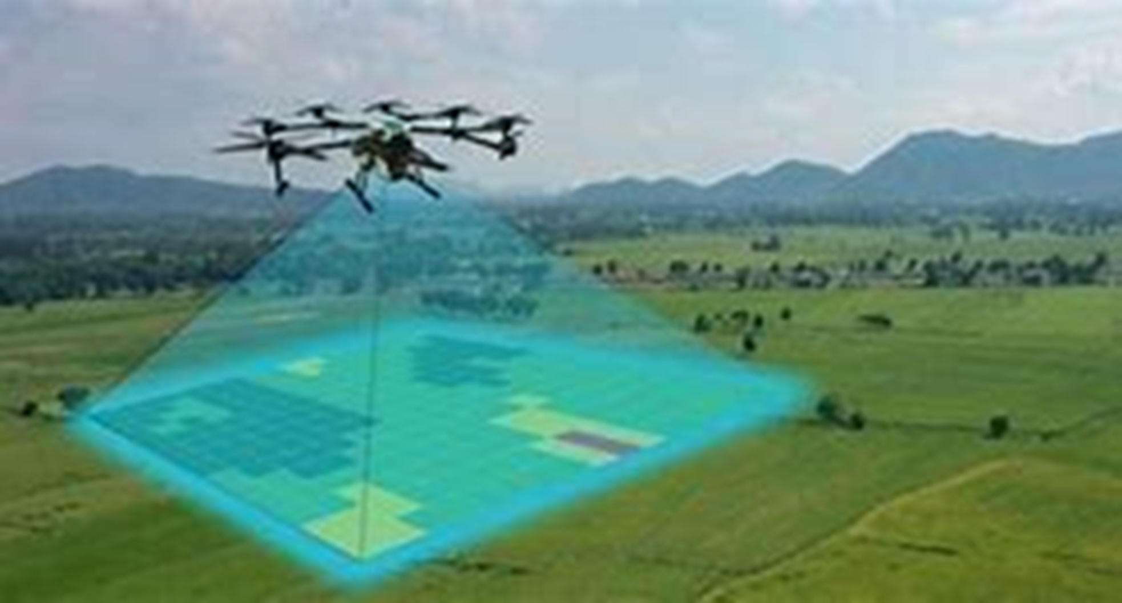
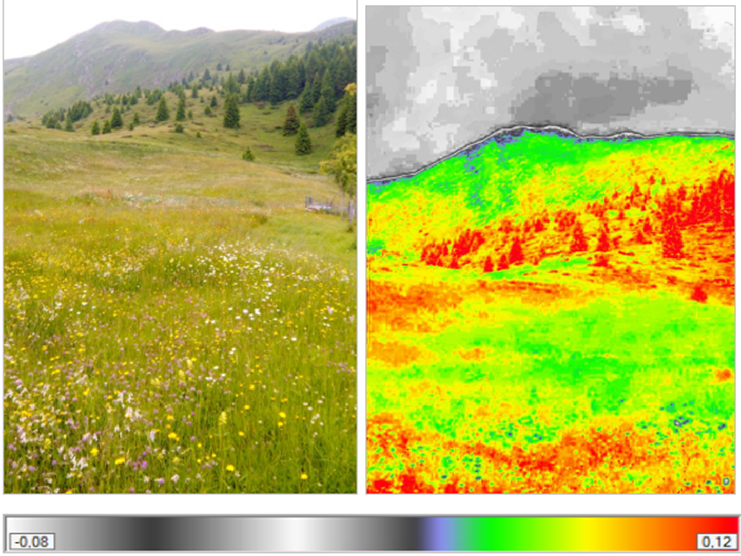
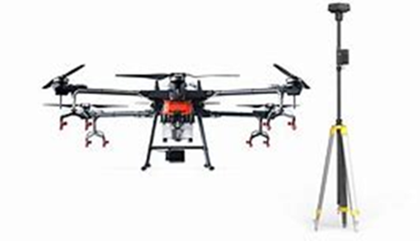
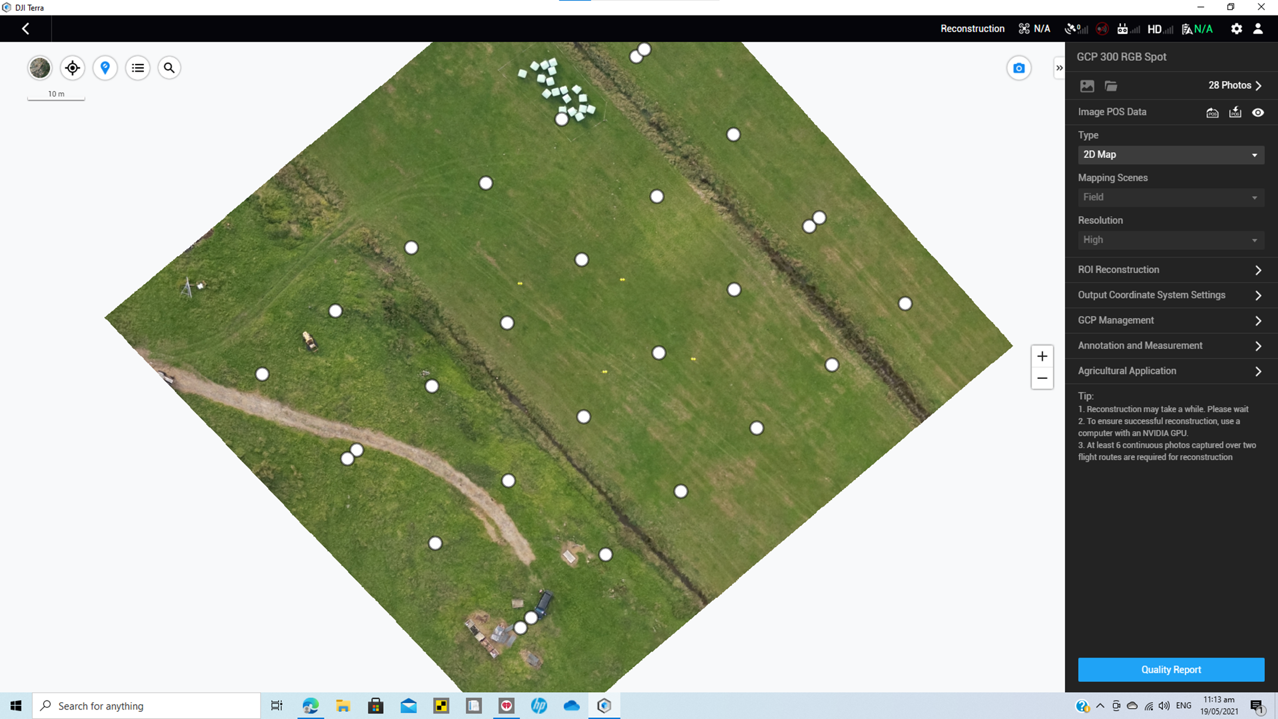
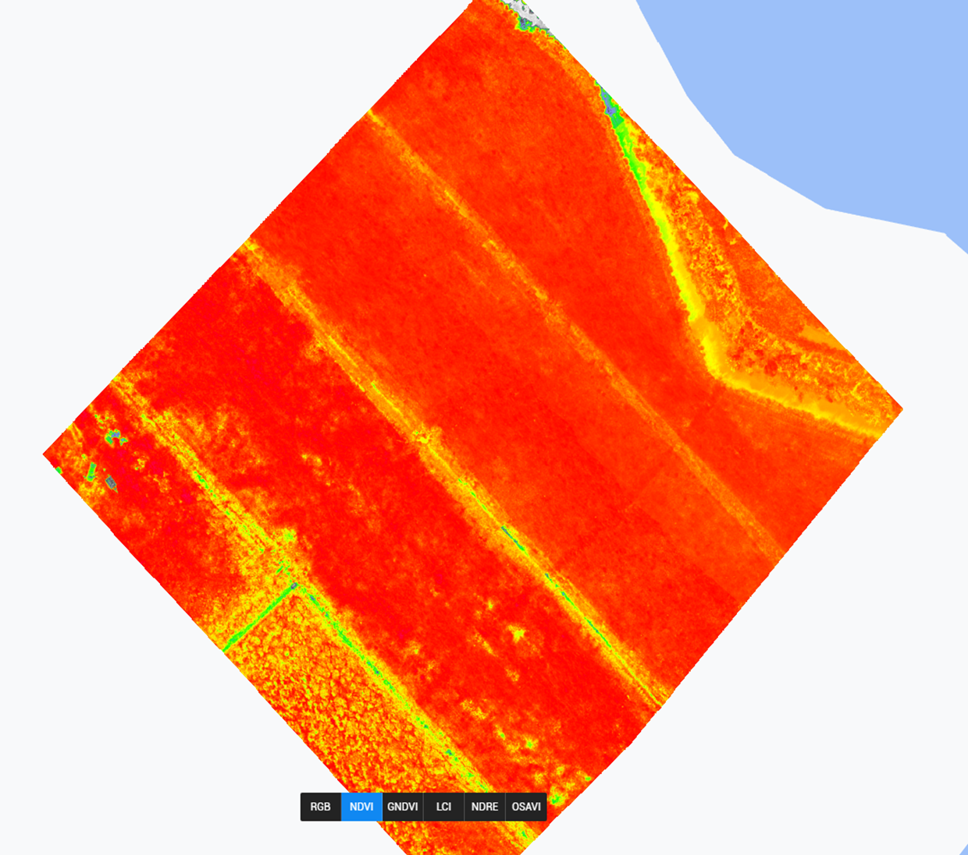
Precision Multispectral Mapping and Spraying
Plant Health is determined by analysing the ‘Spectral Signature’ of a crop.
A high accuracy drone takes a series of photographs at different wavelengths, mapping the area.
Locations requiring treatment are selected by the client, and downloaded into a spray drone.
Spray Drone applies Liquid/Solid chemicals with same high accuracy to target areas.

